Slide 1
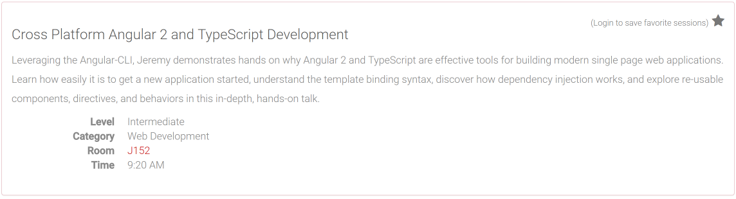
@AtlCodeCamp
https://AtlantaCodeCamp.com/2016

Slide 2




Platinum Sponsors

Slide 3







Gold Sponsors

Slide 4





SWAG Sponsors
Silver Sponsors

Slide 5
Surveys and Prizes
Please complete the session and event surveys!
1 ticket per session survey
1 ticket for the event survey
1 ticket for completing the booth game
Drawing for prizes begins at 5pm in Q202

Slide 6


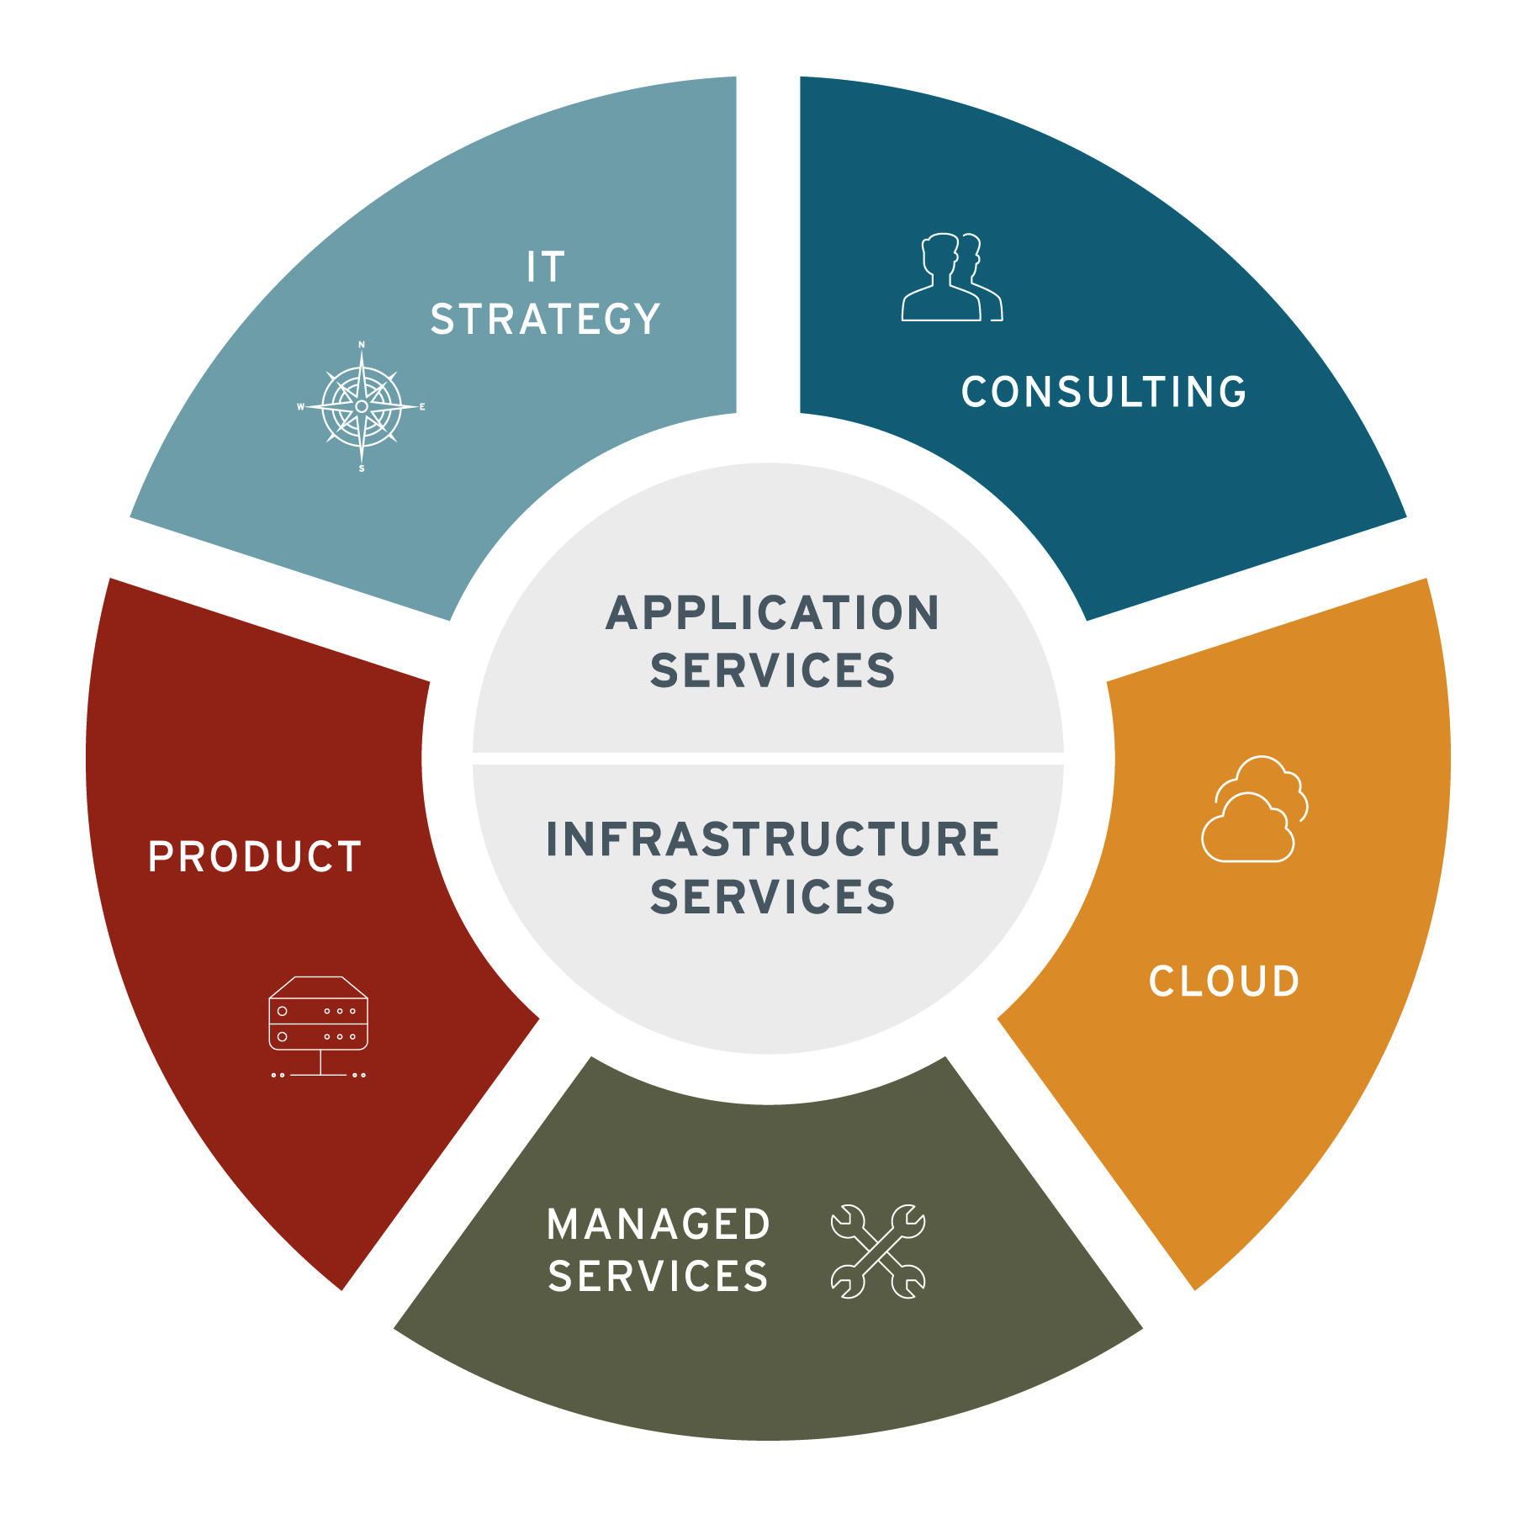


About iVision
About iVision
A privately held, IT consulting firm headquartered in Midtown, Atlanta.
At iVision, we seek to understand our clients’ business first. We work with clients to architect, transform and support their technology — enabling them to realize their vision of a better tomorrow.
The iVision Difference
Engineering Expertise
White Glove Service
Delivery Assurance
Flexible Business Model
Proven Partner Ecosystem
Culture & People
Jeremy Likness| Director of App Dev
https://github.com/JeremyLikness
http://bit.ly/coderblog

Slide 7

Agenda
Pre-requisites
Getting Started / Angular-CLI
Why?
Demo
Q&A

Slide 8



Getting Started
https://nodejs.org/
https://code.visualstudio.com/
https://angular.io/

Slide 9

Angular-CLI
npm install -g angular-cli
ng new my-project
cd my-project
ng serve

Slide 10
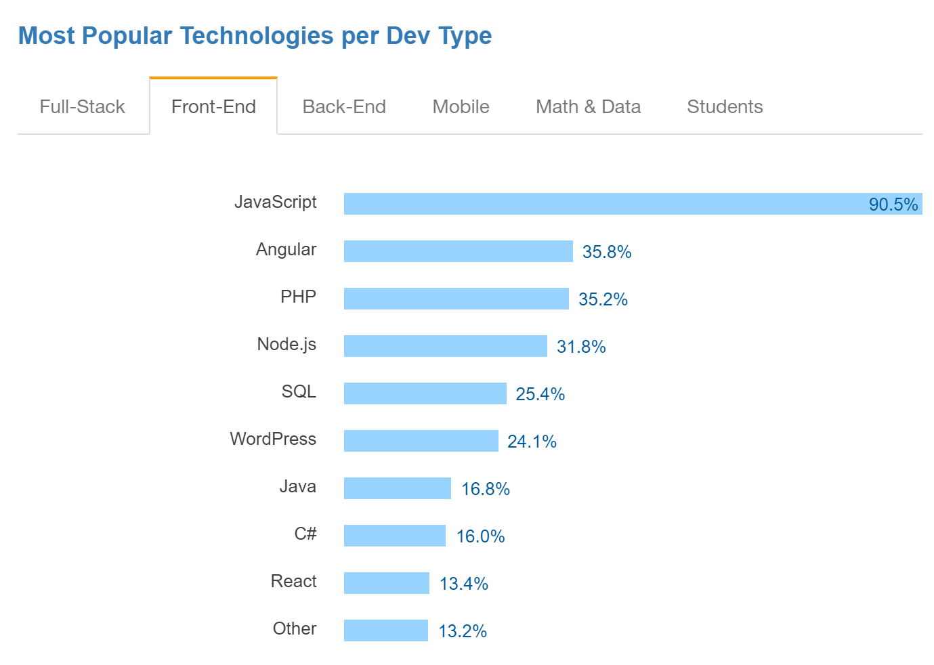
Why Angular?
Three D’s of Web Development: http://bit.ly/3dofweb
Declarative vs. Imperative
Data-binding
Dependency Injection
Components and Templates
Code Reuse
Parallel Development
Testability
Performance
Source: http://stackoverflow.com/research/developer-survey-2016

Slide 11

Why Angular 2?
Small footprint (á la carte)
Easy to read, understand, and learn declarative interface
Improved performance (5x rendering in all scenarios over Angular 1.x)
Great CSS management (CSS per component)
Module prefixing (easier to move related files in large projects)
Server-side rendering with Angular universal
Testing support
Advanced scaffolding with Angular-CLI (Webpack!)
TypeScript (stay tuned…)

Slide 12

Why TypeScript? (1 of 2)
“I cannot say I have ever been a Microsoft fan but TypeScript has ‘softened’ me, it is easily one of the best web technologies to arrive in the past 3 years.” - https://tedpatrick.com/2013/06/25/7-months-with-typescript/
“Overall, TypeScript is wonderful to work with. It helps developers catch errors quickly, adds types and type-checking, and documents your progress so that if someone else wants to contribute, or you need to return to your work months later, you can easily pick up where you left off.” - http://www.livetiles.nyc/blog/typescript-a-digital-workplace-success-story/
“… we use TypeScript not because we’re part of Microsoft, but because we find tremendous value by improving our productivity and keeping our quality high which together allow us to move much faster.” - https://medium.com/@delveeng/why-we-love-typescript-bec2df88d6c2#.pzp9xp7an

Slide 13
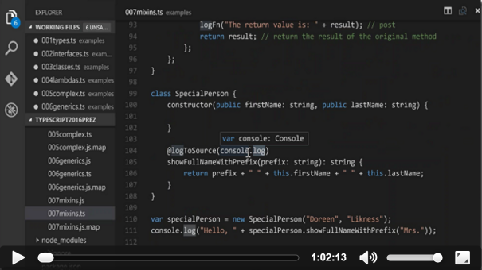
Why TypeScript? (2 of 2)
http://bit.ly/typescriptvid

Slide 14
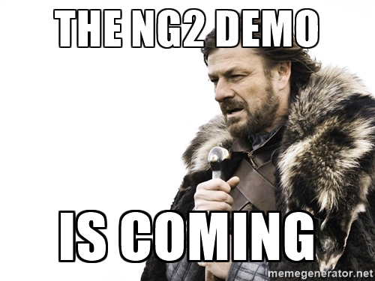
What time is it?

Slide 15
Serve, Test, E2E, & Build
Generate a service
DI
View models
Bindings
Local variables
Events
CSS
Components
Directives
Added module

Slide 16




Questions?
http://ivision.com/author/jlikness
https://twitter.com/jeremylikness
https://linkedin.com/in/jeremy.likness
http://stackoverflow.com/users/228918/jeremy-likness
https://github.com/JeremyLikness
http://csharperimage.jeremylikness.com/

